Slide 1
HOTEL MANAGEMENT SYSTEM
GROUP 13
Burak Sazlı 20200808703
Tahir Emre Semiz 20200808058
Alim Kadir Kara 20190808013
Ahmet Görkem Durum 20190808046
Anıl Can Alparslan 20190808068

Slide 2
Introductıon
A lot of people use hotel to stay every day. For holiday, business, activities etc.
This puts a huge workload on hotels and employees.
Well designed hotel management system can solve this problem easily. That’s why we are here.

Slide 3
About hotel management system
These are systems developed for hotels to serve their customers faster and more effectively. It helps employees to view customer and room lists, change bookings’ details, add a new customer and remove a booking.

Slide 4
WHY US?
Our system has a user friendly interface and everyone can use it easily. We guarantee that the time taken for a new employee to learn the system will not exceed 1 week.
We will provide you a fast, flawless system. You will not encounter any errors caused by our system.

Slide 5
Fact fındıng technıques
Research
We researched other hotel management systems on internet. And also we examined previous year students’ slides and works.

Slide 6
Database desıgn

Slide 7
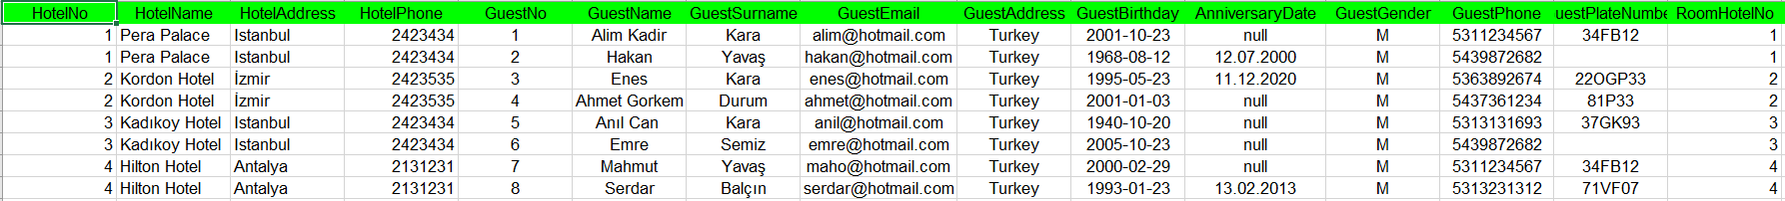
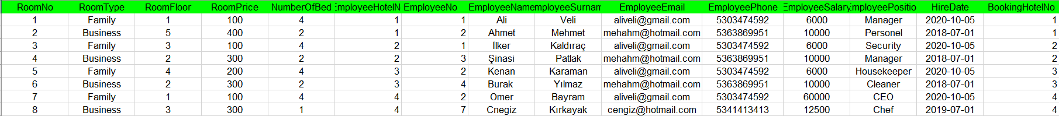
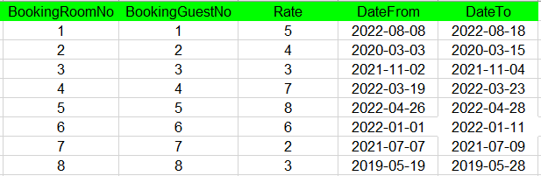
unf

Slide 8
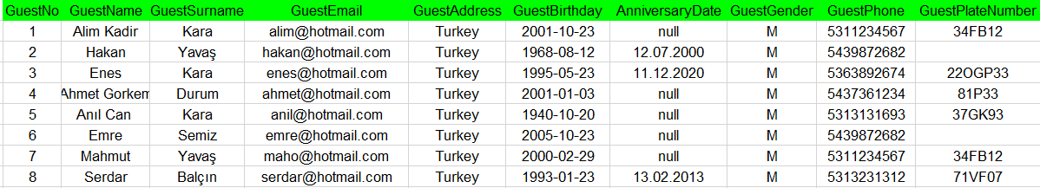
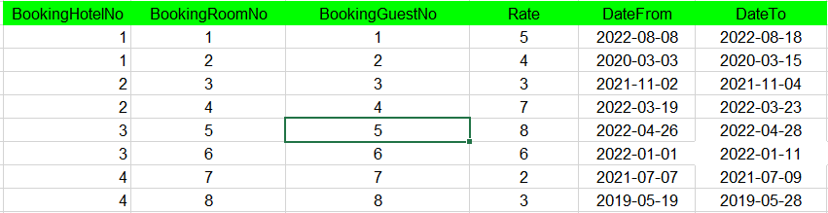
3nf
Guest Table
Booking Table

Slide 9
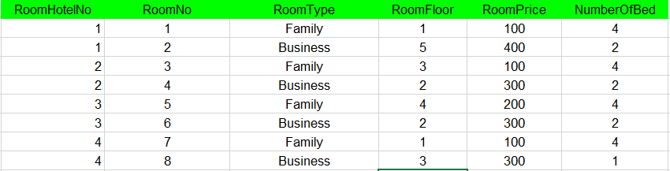
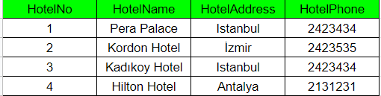
3NF
Room Table
Hotel Table

Slide 10
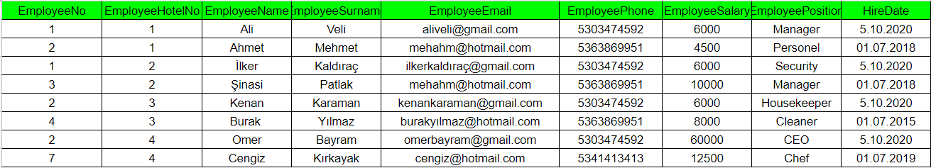
3NF
Employee Table

Slide 11
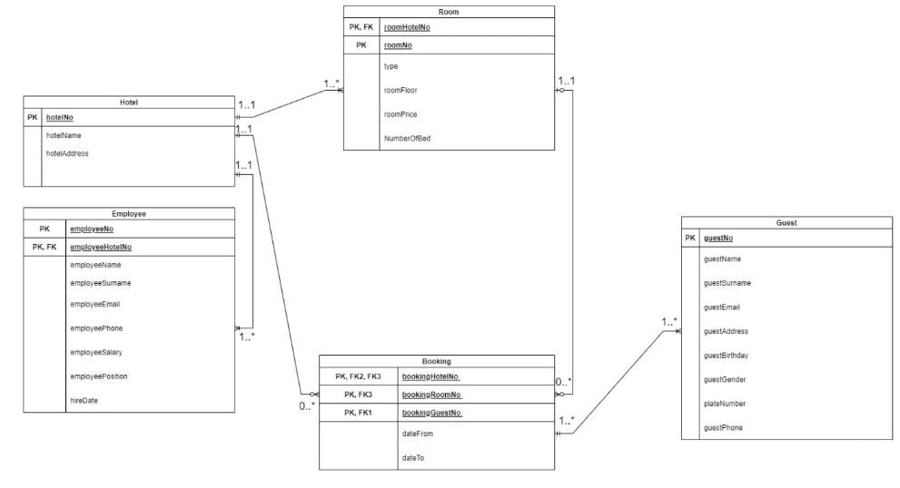
Er dıagram

Slide 12
user ınterface AND QUERIES

Slide 13
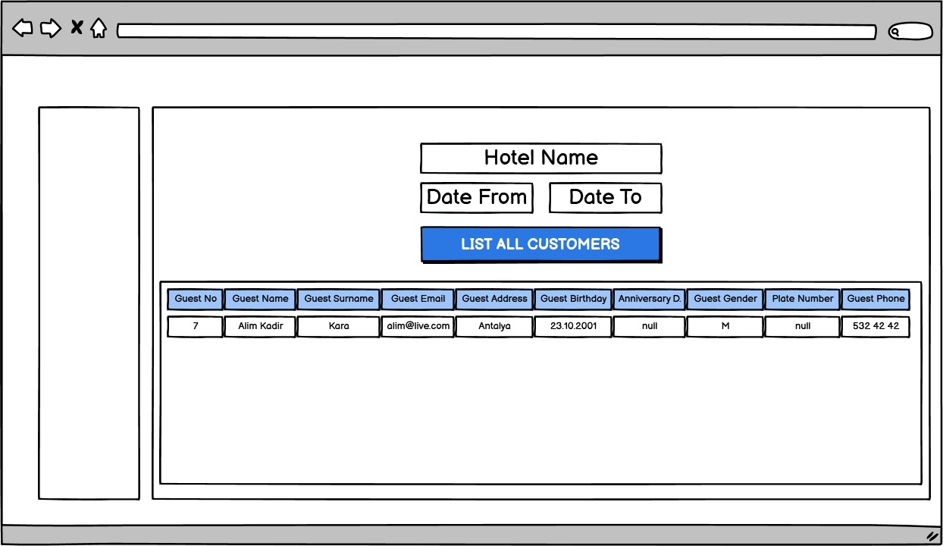

Slide 14
List all customers staying at a particular hotel on a given date
SELECT g.*
FROM Guest g, Booking b, Hotel h
WHERE "wanted date" BETWEEN b.dateTo AND b.dateFrom AND
b.bookingHotelNo=h."hotelNo of the hotel wanted" AND
b.bookingGuestNo=g.guestNo

Slide 15
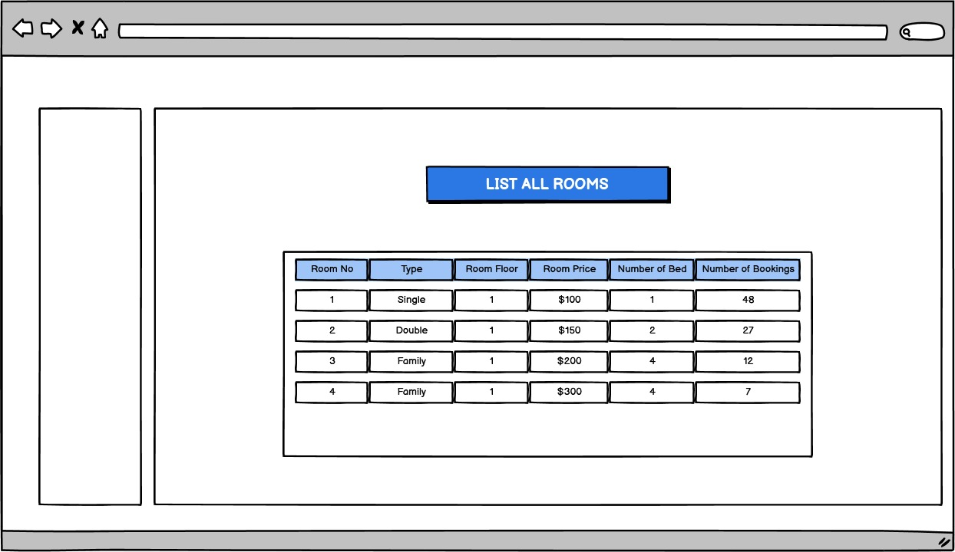

Slide 16
List all rooms and how many bookings there have been for each
SELECT r.*, COUNT(r.roomNo)
FROM Room r, Booking b
WHERE r.roomNo = b.bookingRoomNo
GROUP BY r.roomNo

Slide 17
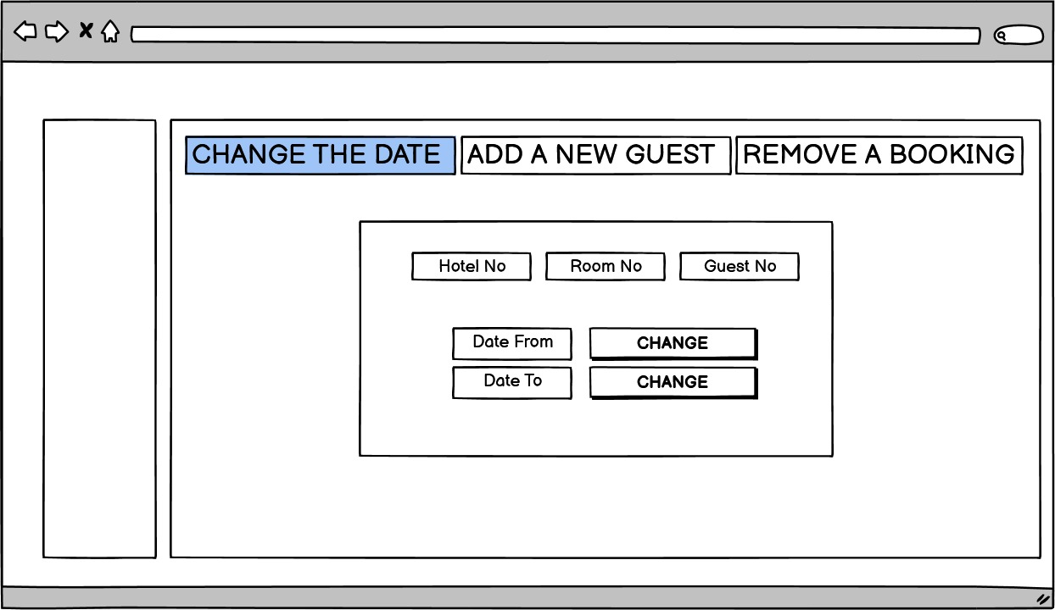

Slide 18
Change the start date for a booking
UPDATE Booking
SET dateFrom="Which date user want"
WHERE bookingHotelNo = "HotelNo of the reservation wanted to change" AND
bookingRoomNo = "RoomNo of the reservation wanted to change" AND
bookingGuestNo = "GuestNo of the reservation wanted to change"

Slide 19
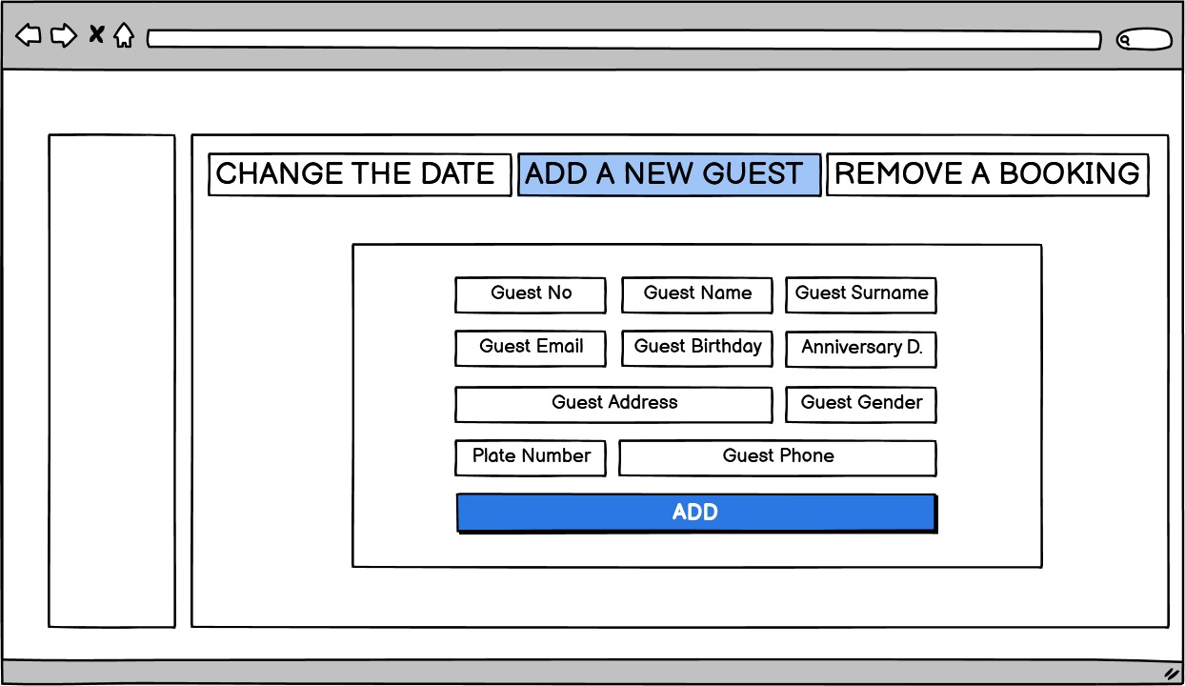

Slide 20
Add a new guest
INSERT INTO Guest
VALUES (15 , 'ali', 'emir','aliemir@mail.com','Aydın','1995-02-08, M, 09A09 ,05451234567)

Slide 21
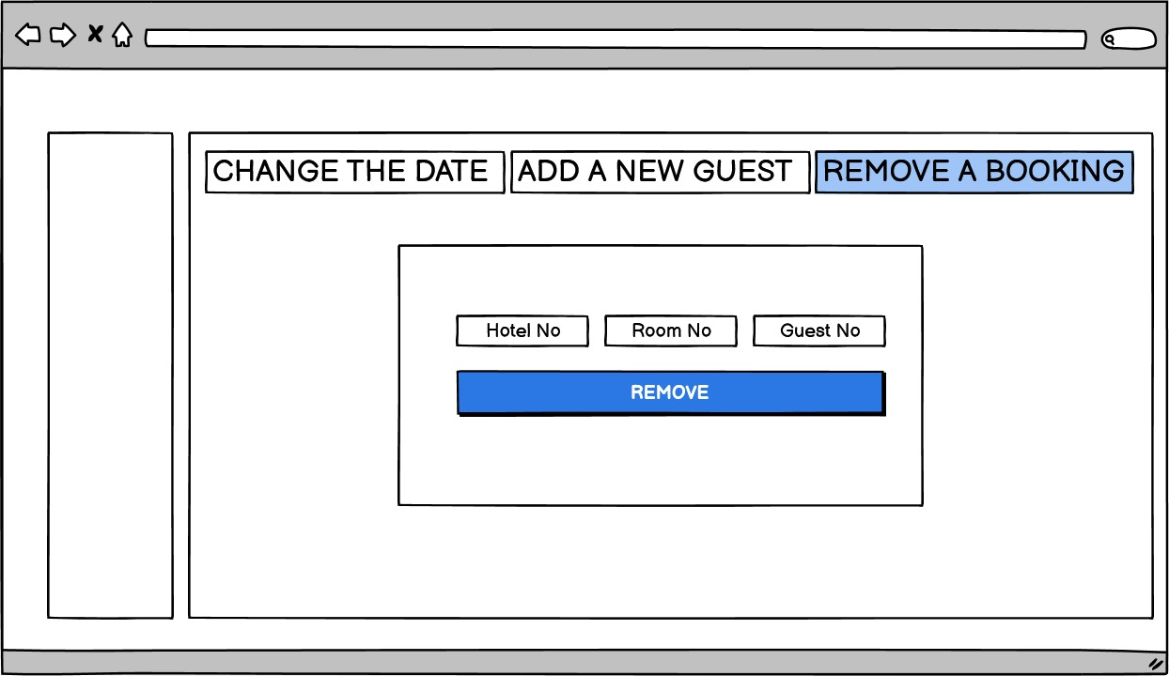

Slide 22
Remove a bookıng
DELETE
FROM Booking
WHERE bookingHotelNo = "HotelNo of the reservation wanted to delete" AND
bookingRoomNo = "RoomNo of the reservation wanted to delete" AND
bookingGuestNo = "GuestNo of the reservation wanted to delete"

Slide 23
THANKS FOR LISTENING

